Slide 1

HR Compensation Analysis
Pietro Keuter

Slide 2
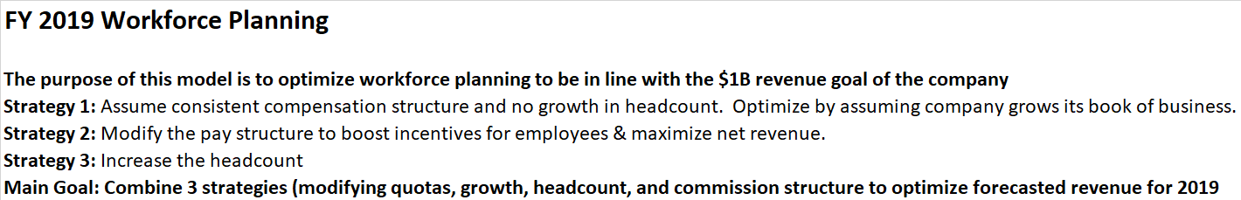
Prior Analysis – Assumptions and review
We reviewed high level strategies for revenue growth within the company, targeting $1B in revenue for FY 2019

Slide 3
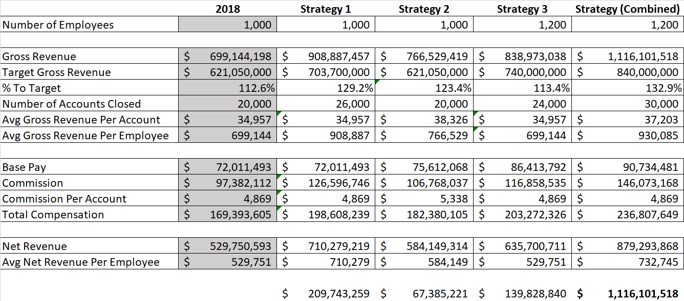
Prior Analysis – Model

Slide 4
Pivot to New analysis– Compensation Review
Previous analysis does not review how optimized each account level is in terms of payout structure
Review our internal performance versus industry benchmarks to see where cost savings can be implemented.
How should we alter our total compensation package to maximize these cost savings?

Slide 5
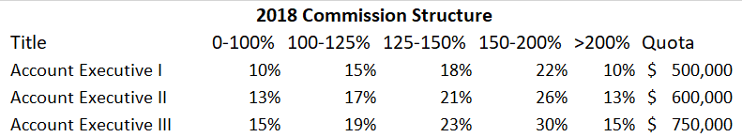
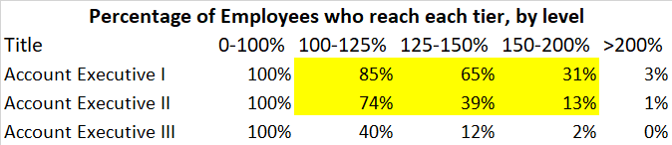
Current Commission and Base pay structure
High premium on ‘over-selling’
Large percentage of each account level reaching the 100-125% & 125-150% tiers on commission pay

Slide 6
Optimization of commission pay – Baseline (Compensation increase of 2.5%)
This scenario assumes a 5% increase in revenue, as well as a 2.5% increase in compensation, overall.
Net Revenue: $560M

Slide 7
Optimization of commission pay – model 1 (Lower Commission Payout)
With a lower commission payout, we can further increase potential net revenue. Assumes 5% increase in gross revenue.
Net Revenue: $569M

Slide 8
Optimization of commission pay – model 2 (Quota raise)
Assumes 5% increase in gross revenue, while increasing commission quotas.
Net Revenue: $569M

Slide 9
Optimization of commission pay – model 3 (Combination)
Assumes 5% increase in gross revenue, while increasing commission quotas as well as lowering commission rates.
Net Revenue: $587M

Slide 10
Results: Which method to choose?

Slide 11
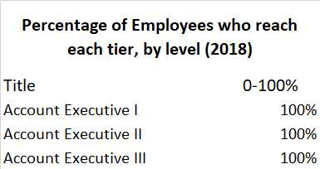
Recommendation: Model 3
Highest cost savings immediately (~13%)
Increased quotas equal higher incentive to sell
Stabilized commission structure moving forward
No longer rewarding mediocrity

